Slide 1
Imposing sparsity
Rigde,lasso and elastic net

Slide 2
Sparsity purpose
How to decrease the dimension and identify the most important variables, and get rid of the redundant or irrelevant variables.

Slide 3
The classic approach
The same way as we did with the OLS
Backwards selection
Forwards selection
Cons: can take extremely long time and final model may be hard to interprete
Pros: the optimal model will be found

Slide 4
Spasity methods
Shrinks all coefficients of model towards 0 instead of increasing/decreasing model complexity
Three established standard techniques
Ridge regression uses quadratic shrinkage, L2-norm
Lasso regression uses absolute-value shrinkage, L1-norm
Elastic net which is a hybrid method

Slide 5

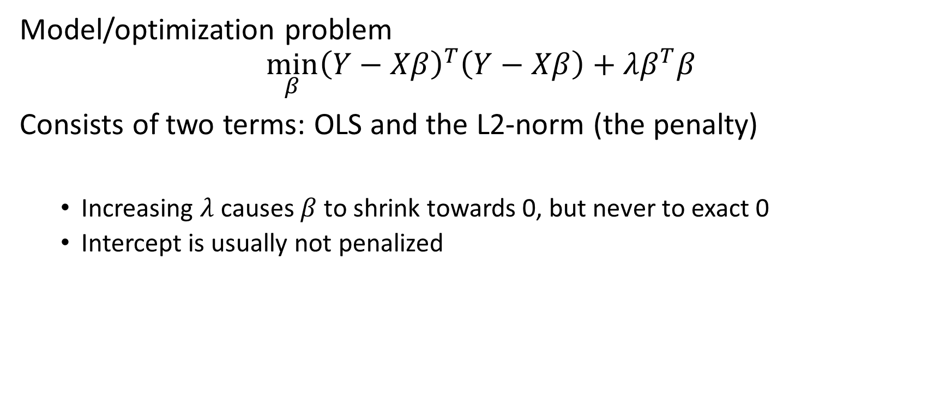
Ridge
Model/optimization problem
$$\min_{β}{{\left(Y−Xβ\right)}^{T}\left(Y−Xβ\right)+λβ^{T}β}$$
Consists of two terms: OLS and the L2-norm (the penalty)
Increasing $λ$ causes $β$ to shrink towards 0, but never to exact 0
Intercept is usually not penalized

Slide 6
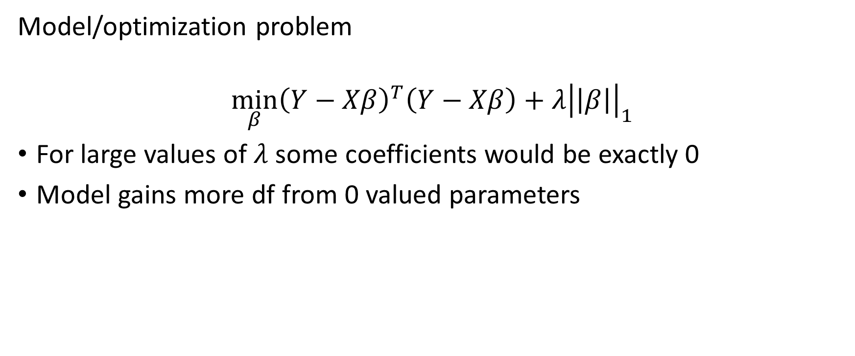
Lasso
Model/optimization problem
$$\min_{β}{{\left(Y−Xβ\right)}^{T}\left(Y−Xβ\right)+λ{\left|\left|β\right|\right|}_{1}}$$
For large values of $λ$ some coefficients would be exactly 0
Model gains more df from 0 valued parameters

Slide 7
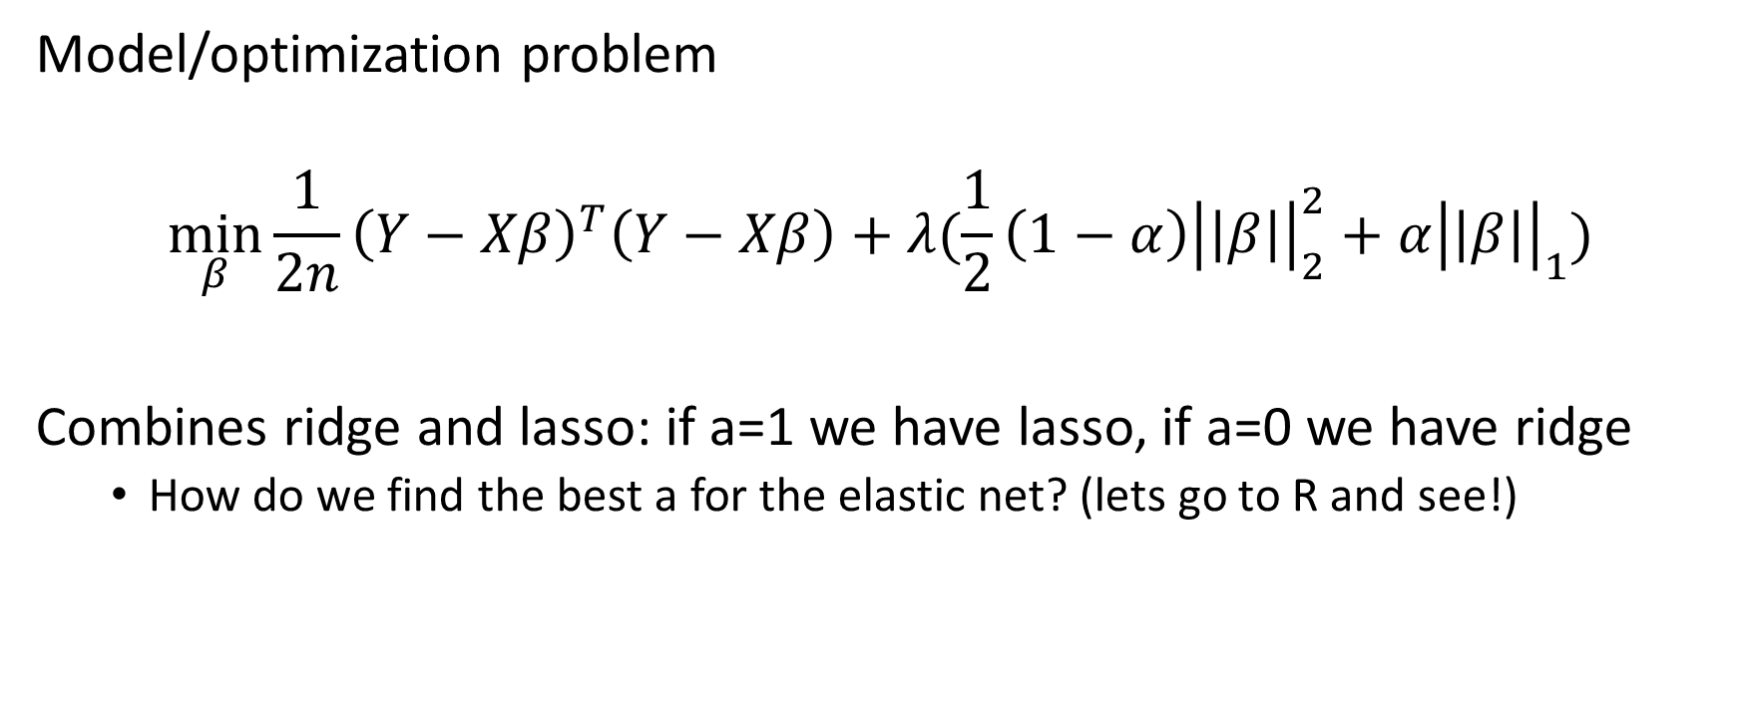
Elastic net
Model/optimization problem
$$\min_{β}{{\frac{1}{2n}\left(Y−Xβ\right)}^{T}\left(Y−Xβ\right)+λ(\frac{1}{2}\left(1−α\right){\left|\left|β\right|\right|}_{2}^{2}+α{\left|\left|β\right|\right|}_{1})}$$
Combines ridge and lasso: if a=1 we have lasso, if a=0 we have ridge
How do we find the best a for the elastic net? (lets go to R and see!)

